Slide 1
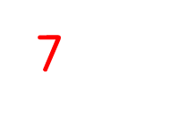
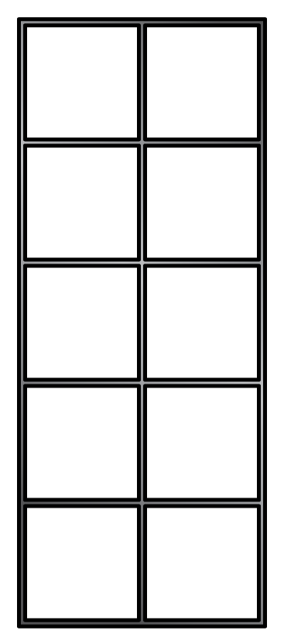
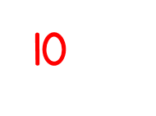
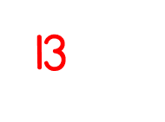
Year 1 | Week 1 | Day 1

Slide 2
Year 1 | Week 1 | Day 2

Slide 3
Year 1 | Week 1 | Day 3

Slide 4
Year 1 | Week 1 | Day 4

Slide 5
Year 1 | Week 1 | Day 5

Slide 6
Year 1 | Week 2 | Day 1

Slide 7
Year 1 | Week 2 | Day 2

Slide 8
Year 1 | Week 2 | Day 3

Slide 9
Year 1 | Week 2 | Day 4
17 , 9 , 14

Slide 10
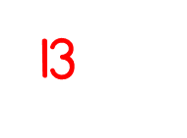
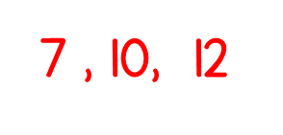
Year 1 | Week 2 | Day 5
7 , 12 , 10

Slide 11
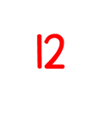
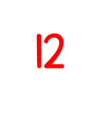
Year 1 | Week 3 | Day 1

Slide 12
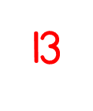
Year 1 | Week 3 | Day 2

Slide 13
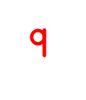
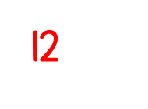
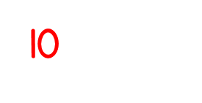
Year 1 | Week 3 | Day 3

Slide 14
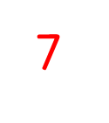
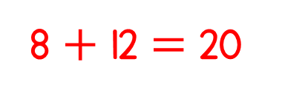
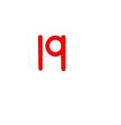
Year 1 | Week 3 | Day 4

Slide 15
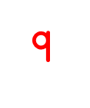
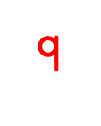
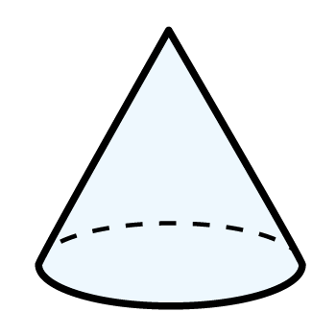
Year 1 | Week 3 | Day 5

Slide 16
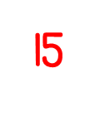
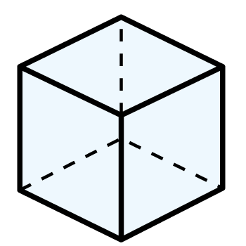
Year 1 | Week 4 | Day 1

Slide 17
Year 1 | Week 4 | Day 2

Slide 18
Year 1 | Week 4 | Day 3

Slide 19
Year 1 | Week 4 | Day 4

Slide 20
Year 1 | Week 4 | Day 5
$$=$$

