Slide 1
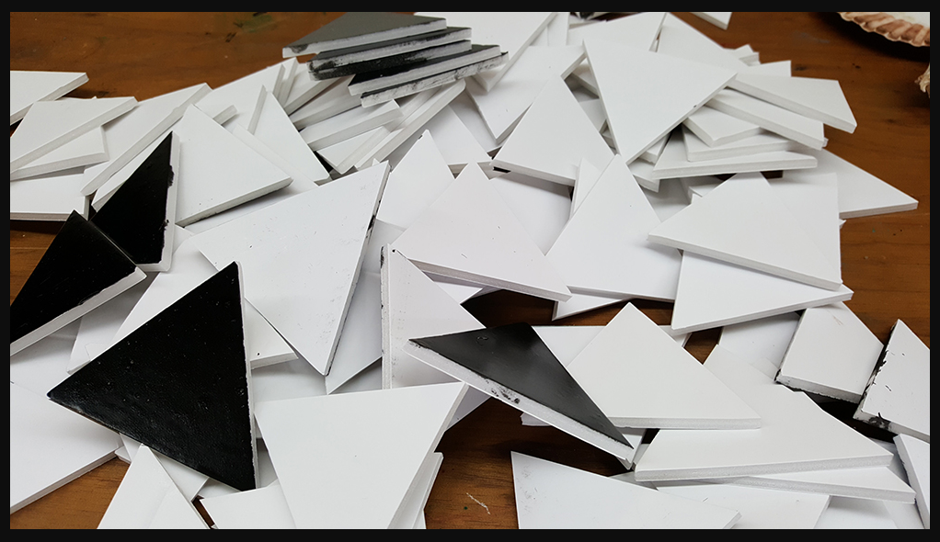
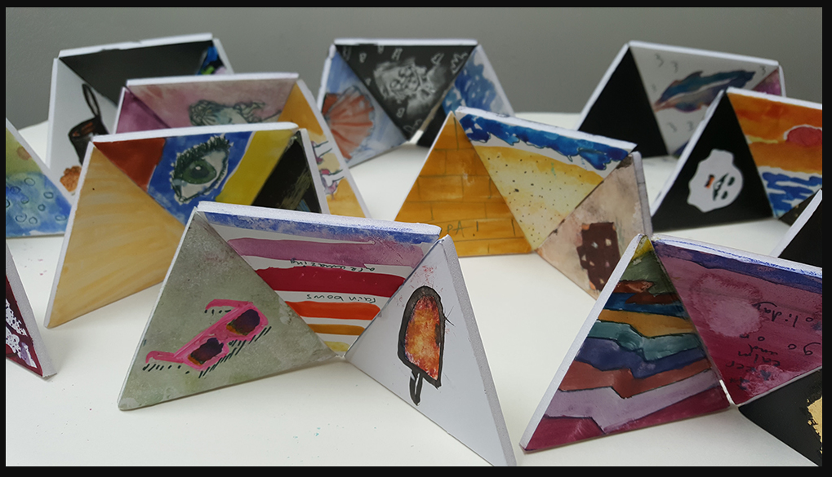
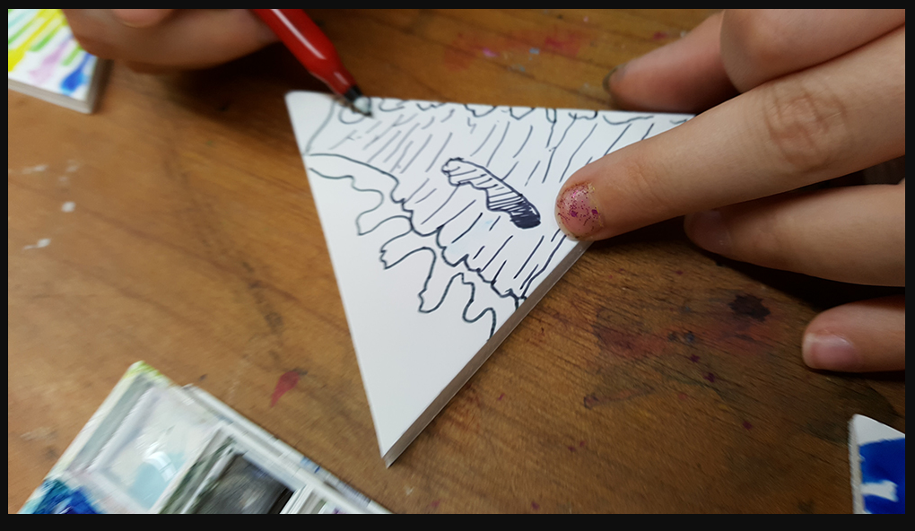
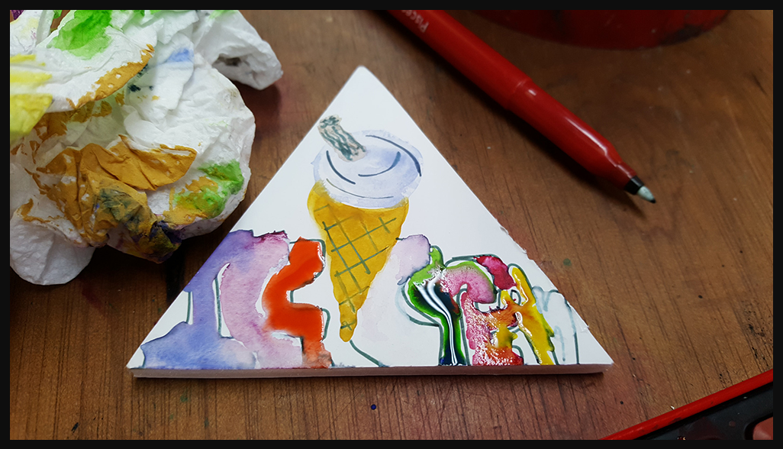
WAVE BOWL- by the end of this topic you will have learnt to design, make and evaluate your own wave bowl
Key Vocabulary
Mosaic | a decoration on a surface made by setting small pieces of glass, tile, or stone of different colours into another material so as to make pictures
Stimuli | Something that causes a response – a piece of music that we can use to create art from
Precision | To be exact and accurate
Embellishing | To make beautiful with decoration
Collaborative | Working in a group. Coming up with ideas together
3. To cut materials with precision
We will cut foam board into triangles. Some of these have been painted with black ink on the back.
1. To explore different music stimuli and to express this through drawings
We will look at a range of stimuli including poetry and music to inspire us. We work to a theme based upon our topic.
4. To show feelings through your design and to join materials effectively selecting your own materials
2. In groups, design a wave bowl from your music stimuli
To evaluate yours and others final pieces
DESIGN MAKE EVALUATE

