Slide 1
Active
and passive verbs
What was said just now?

Slide 2
Subject and object (revision)
What is the subject of each of these sentences? Remember The subject of a sentence is the person, place, thing, or idea that is doing or being something.
The dog barked.
The dog bit me.
I bit the dog.
You must get off the bus.
This bus goes to Leeds.
I am a dog.
The dog barked.
The dog bit me.
I bit the dog.
You must get off the bus.
This bus goes to Leeds.
I am a dog.

Slide 3
Subject and object (revision)
What is the object of each of these sentences? An object of a sentence is the receiver of the action. Do they all have an object?
The dog barked.
The dog bit me.
I bit the dog.
You must go to Leeds on the bus.
I’m sharpening my pencil.
Get a new pencil.
The dog barked.
The dog bit me.
I bit the dog.
You must go to Leeds on the bus.
I’m sharpening my pencil.
Get a new pencil.

Slide 4
Discuss with a partner:
Every sentence must have a subject.
True or false?
If you think it’s false, give an example of a correctly formed sentence which has no subject.

Slide 5
Discuss with a partner:
Every sentence must have an object.
True or false?
If you think it’s false, give an example of a correctly formed sentence which has no object.

Slide 6
All in order…
object - subject - verb :
What is their usual order in an English sentence?
Subject
Verb
Object

Slide 7
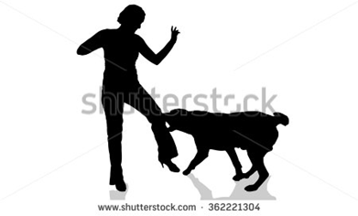
Passive verbs
A passive verb lets us use the object of the action as the subject of the sentence.
The dog bit me. (active verb)
I was bitten by the dog. (passive verb)

Slide 8
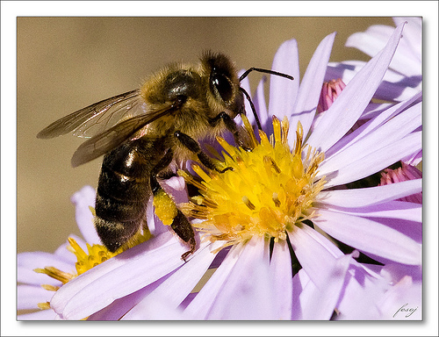
Turn these active verb sentences into passive verb sentences:
Bees make honey.
Honey is …
The sun
warmed and
dried him.
A passing herd of buffalo nearly flattened us.
A projecting ledge of rock broke my fall.
Honey is made by bees.
He was warmed and dried by the sun.
We were nearly flattened by a passing herd of buffalo.
My fall was broken by a projecting ledge of rock.

Slide 9
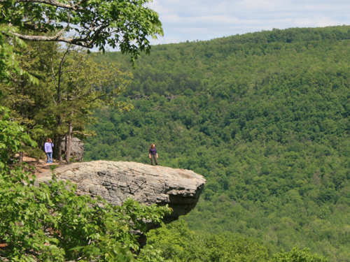
Turn these passive verb sentences into active verb sentences:
My fall was broken by a
projecting
ledge of rock.
The robbers
were seen by
a member
of the public.
A projecting ledge of rock broke my fall.
A member of the public saw the robbers.

Slide 10
Grammar nerds’ corner
Passive verbs can be in any tense: past, present, future and so on.
That’s why it is not called the passive “tense” but the passive voice of the verb.
Examples: It amuses me – present tense, active voice.
I am amused – present tense, passive voice.
I was amused – past tense, passive voice.

