Slide 2
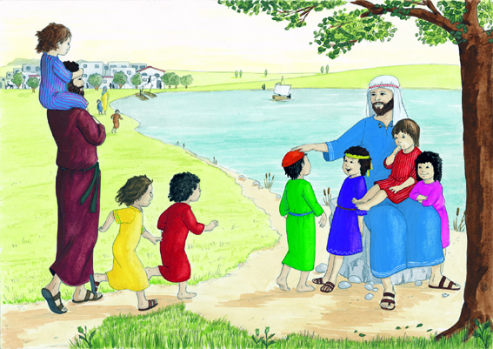
People brought their children to Jesus,
he took them in his arms and he blessed them

