Slide 1


FAIRTRADE
challenge
Click on the buttons
to choose your
answers.

Slide 2

When is Fairtrade fortnight?
Two weeks in
November
and December
Two weeks in
February and
March
Two weeks
in July and August
It changes every year

Slide 3
Sorry, click to
try again
Show me the
right answer

Slide 4

Correct!
Fairtrade Fortnight
is always during two weeks in
in February and
March

Slide 5
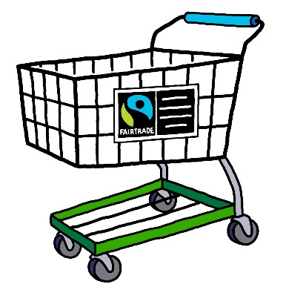
How many products have the
Fairtrade mark?
Under 500
Over 2,500
Nearly 3,000
Over 4,500

Slide 6

Sorry, click to
try again
Show me the
right answer

Slide 7
Correct!
There are over
4,500 products
certified with the Fairtrade mark in the
UK and the number is still growing!

Slide 8
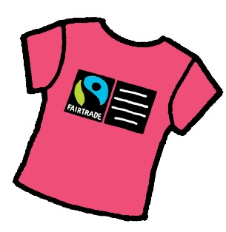
Who set up the Fairtrade Foundation?
The Trade Justice
Movement
CAFOD, Christian Aid,
Oxfam, Traidcraft and
the World Development
Movement
The Department of
Trade and Industry (DTI)
The Queen

Slide 9

Sorry, click to
try again
Show me the
right answer

Slide 10

Correct!
The Fairtrade Foundation was
set up by CAFOD, Christian Aid, Oxfam,
Traidcraft and the World Development
Movement in 1992.

Slide 11
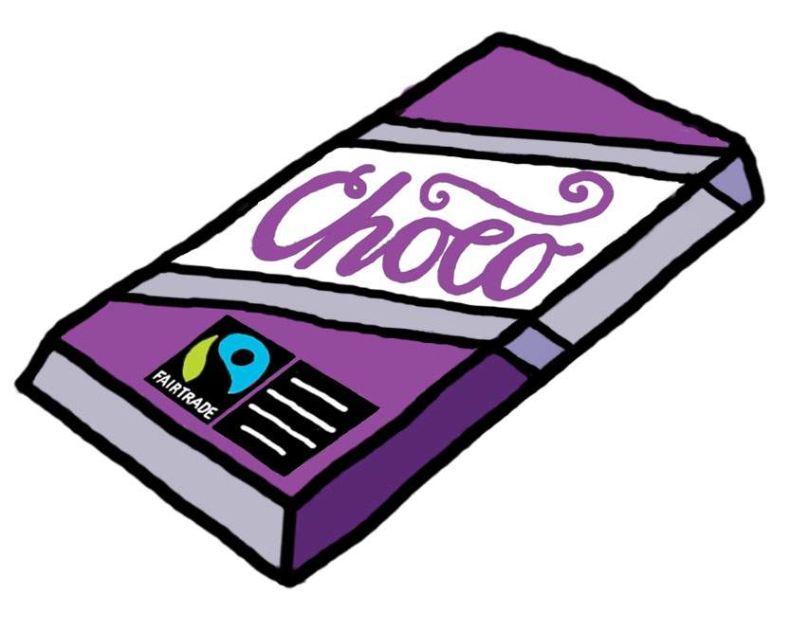
Who makes the Fairtrade
chocolate bar called ‘Divine’?
The Day Chocolate
Company
Mars
Green and Blacks
Cadbury

Slide 12
Sorry, click to
try again
Show me the
right answer

Slide 13
Correct! Day chocolate company
make Divine chocolate bars.
Cadburys and Nestle now have
Fairtrade chocolate bars.
Which ones have you eaten?

Slide 14

How many Fairtrade
schools are there in the UK? (2015)
About 300
Less than 100
Over 1,000
Over 5,000

Slide 15
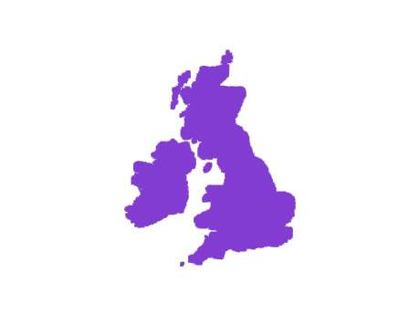
Sorry, click to
try again!
Show me the
right answer

Slide 16
Correct!
There are now over 1,000 Fairtrade schools
in the UK. A school can become Fairtrade
by using Fairtrade products, learning about
how global fair trade works and taking
action in the school and the wider community.

Slide 17


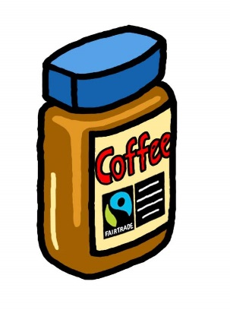

What was the first product to be awarded
the Fairtrade mark in March 1994?
Clipper Tea
Green and Blacks Maya
Gold organic chocolate
Bananas
Café direct coffee

Slide 18



Sorry, click to
try again
Show me the
right answer

Slide 19

Correct! Green and Black’s Maya Gold
organic chocolate received the Fairtrade mark in
March 1994. Soon after Clipper Tea and Café
Direct coffee also gained the mark.
All Green and Black’s chocolate, hot drinks
and baking products are now Fairtrade. The
cocoa farmers in the Dominican Republic where
the cocoa comes from, can now help to
improve their communities.

Slide 20

How many farmers and workers worldwide
are now benefitting from Fairtrade?
2.1 billion
18,000
1.4 million
100,000

Slide 21
Sorry, click to
try again
Show me the
right answer

Slide 22
Correct! 1.4 million farmers
and workers are benefitting from
Fairtrade.

Slide 23

How many people signed Fairtrade Foundation’s
Petition to Make Bananas Fair in 2014?
Over 70,000
Less than 100
18 million
1600

Slide 24
Sorry, click to
try again
Show me the
right answer

Slide 25
Correct! Over 70,000 people
signed Fairtrade Foundation’s
Petition to Make Bananas
Fair in 2014.

Slide 26

How many countries are Fairtrade products
currently sold in?
8
125
75
13

Slide 27
Sorry, click to
try again
Show me the
right answer

Slide 28
Correct! Fairtrade products
currently sold in 125 countries.

Slide 29
Find out more about Fairtrade
by visiting
cafod.org.uk
fairtrade.org.uk
picturemyworld.cafod.org.uk/fairtrade/
Updated February 2016
Illustrations by Mary Gorton and Ellis Nadler

