Slide 1
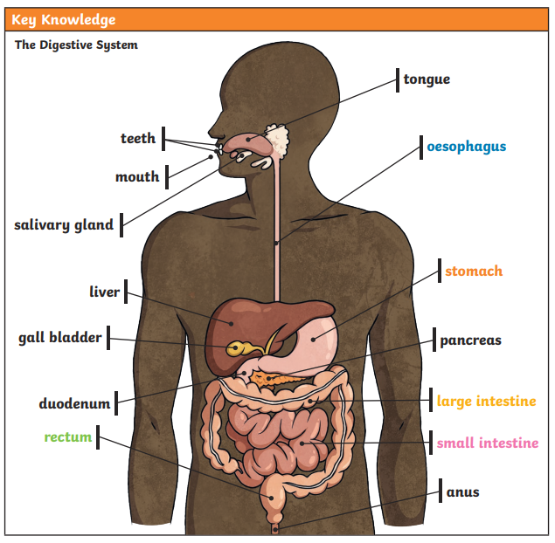
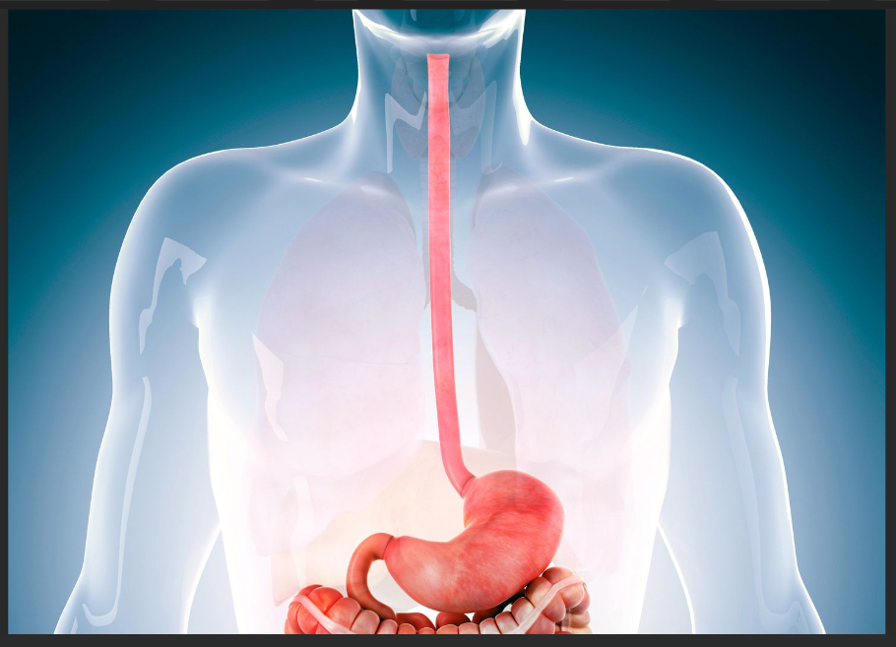
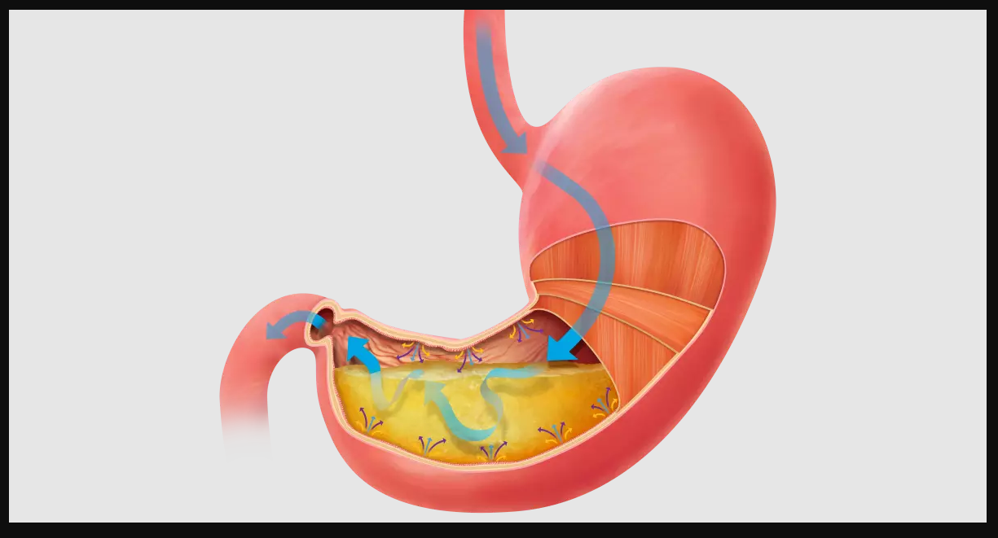
DIGESTION –You will learn to describe the simple functions of the basic parts of the digestive system in humans
Key Vocabulary
Digest | Break down food so it can be used by the body.
Oesophagus | A muscular tube which moves food from the mouth to the stomach.
Stomach | An organ in the digestive system where food is broken down with stomach acid and by being churned around.
Small intestine | Part of the intestine where nutrients are absorbed into the body.
Large intestine | Part of the intestine where water is absorbed from remaining waste food. Faeces are formed in the large intestine
Rectum | Part of the digestive system where faeces are stored before leaving the body through the anus.
To know the parts of the digestive system and to describe the digestive system
2. To describe the function of the oesophagus in the digestive system
The oesophagus is a relatively straight muscular tube through which food passes from the pharynx to the stomach.
3. To describe the function of the stomach.
The stomach is on the upper-left area of the abdomen below the liver and next to the spleen. It stores and breaks down the foods and liquids we eat before they move to digestion

Slide 2
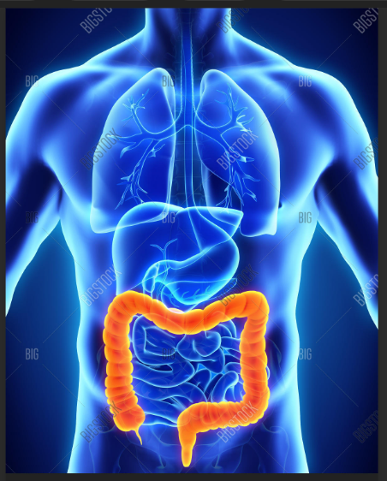
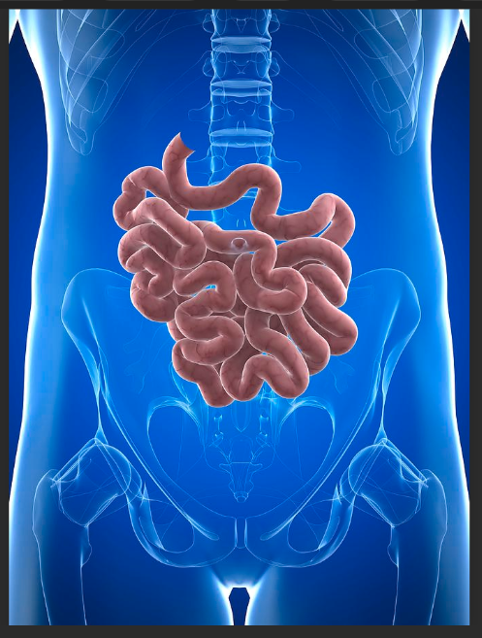
DIGESTION –You will learn to describe the simple functions of the basic parts of the digestive system in humans
4. To describe the function of the small intestine in the digestive system
The main functions of the small intestine are to break down, or digest, food and to absorb nutrients, such as electrolytes, vitamins and minerals. The small intestine is the most important absorbing organ in the GI tract. About 90% of nutrient absorption takes place in the small intestine.
5. To describe the function of the large intestine in the digestive system
The large intestine is the portion of the digestive system most responsible for absorption of water from the indigestible residue of food.
6. To describe the digestive system
Imagine that you are a sandwich. You’re made of fluffy white bread (or wholemeal, whichever you prefer) and are filled with cheese and lettuce. Unfortunately, you’re about to be eaten. Sorry about that. You’re going to write a story describing your journey through the digestive system. Before you start, have a think about the different parts of the digestive system that you will travel through on your journey.

