Slide 1
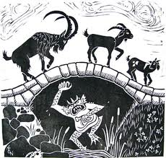
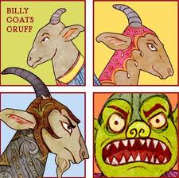
All about Trolls

Slide 2
Where did they come from?
Trolls appeared in many Traditional Tales written in Germany, Denmark, Norway and Sweden.
Can you find them on the map?

Slide 3
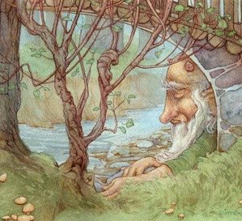
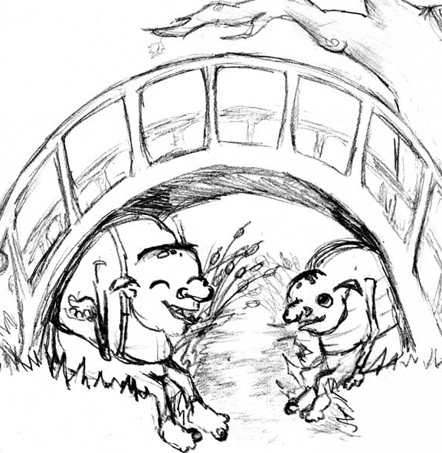
What did they do?
Trolls usually lived in mountains, forests and near lakes.
They often they guarded bridges and roads.

Slide 4
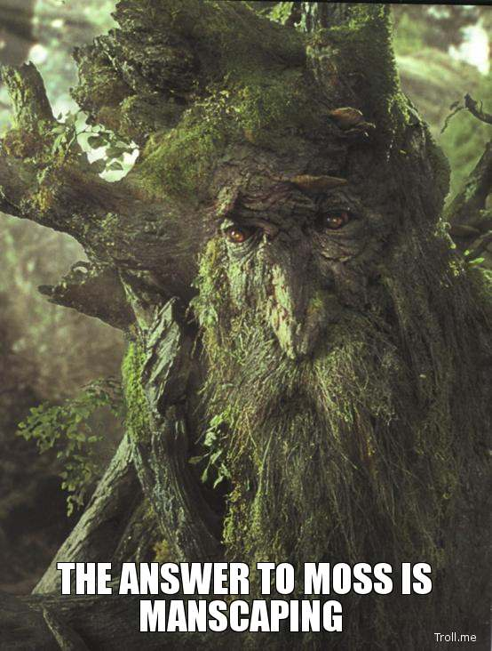
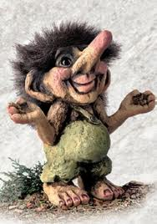
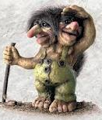
Trolls were giants. They were shaggy and rough-haired, with trees and moss growing on their heads and noses.
Their noses were long and they would stir with it when cooking broth or porridge.
Some even had two or three heads, some only had one eye in the middle of their foreheads.

Slide 5
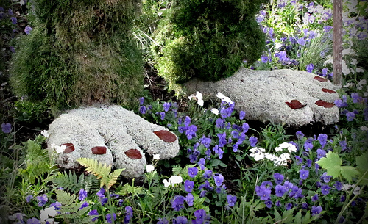
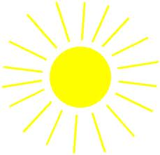
They had four fingers and four toes and a tail resembling that of a cow.
The trolls lived hundreds of years old, but the sunlight turns them into stone.

Slide 6
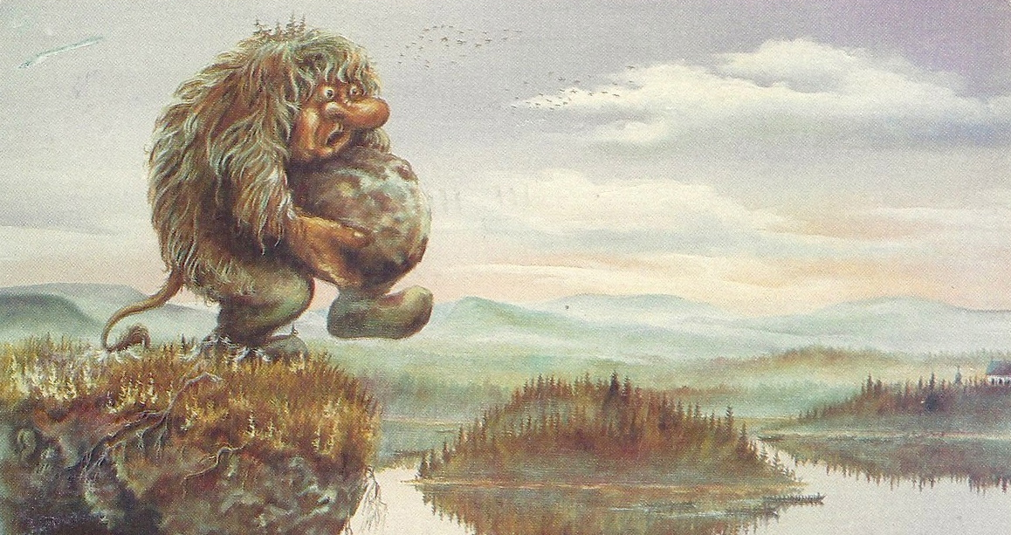
They might have looked frightening, but were actually often quite nice in stories. People would often trick them.
One of the trolls favourite things to do was throw stones at creatures who passed them.

Slide 7
Your Task
You need to design a troll to be in your re-write of the Three Billy Goats Gruff.
Think about ….
What the trolls of Traditional Tales look like. Who can remember?
If your troll may be good or bad.
You need to label your troll with its main features.

Slide 8
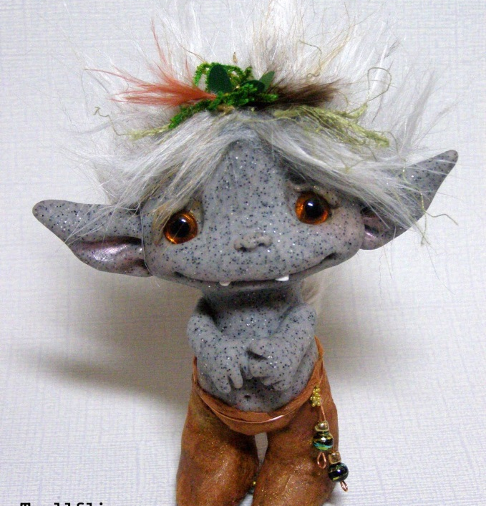
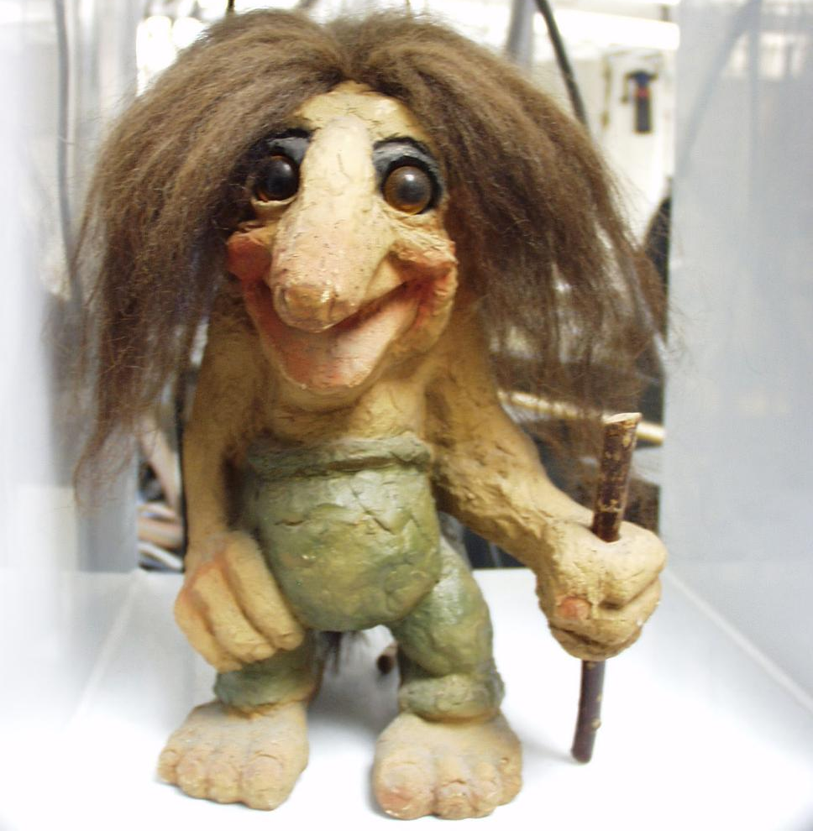
Ideas for your troll designs

