Slide 2
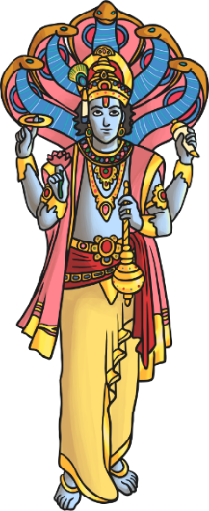
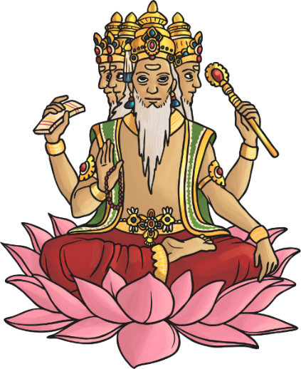
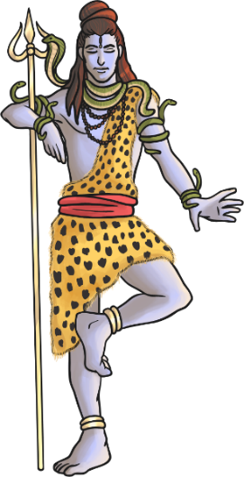
Hindu Deities
Hindus recognise one God, Brahman. The gods of Hinduism are different expressions of Brahman.
These are considered the Trimurti
- the three aspects of the universal supreme God.
v
Vishnu
Brahma
Shiva

Slide 3
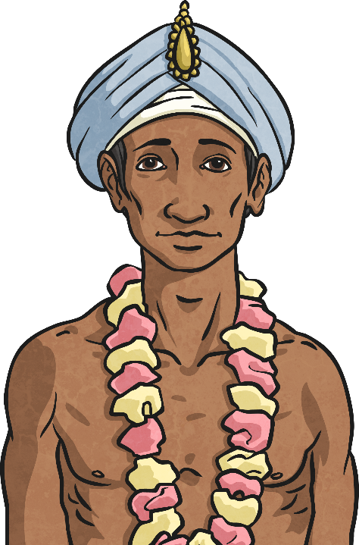
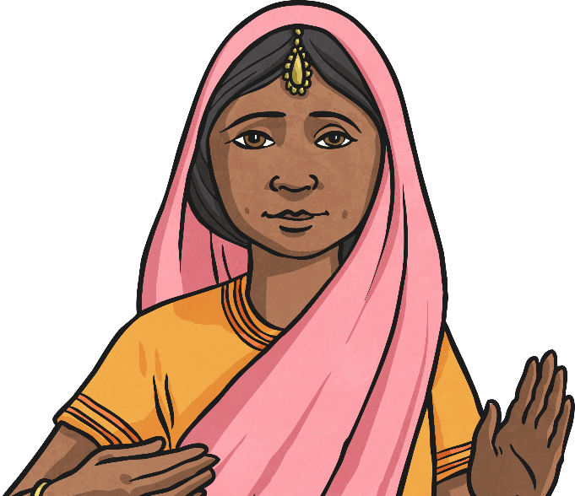
Main Beliefs
Hinduism is a religion that has fused many different traditions and practices. There is no one way to be a Hindu.
However, there are some core beliefs that all Hindus share.
Truth is eternal
Dharma
Reincarnation
Moksha

Slide 4
Main Beliefs - Truth Is Eternal
Hindus believe that they should pursue knowledge and understanding of the truth.
Truth is the only reality.
There is one truth, but the wise can express this in many ways.

Slide 5
Main Beliefs – Dharma
Hindus believe that there are right and wrong ways to behave.
Dharma is a complex idea that includes the right behaviour, following the moral law (and not just what you feel like doing) and taking ones duties seriously.
Dharma is a central part of a Hindu’s daily life.
According to this belief, it is necessary to do the right thing at all times.

Slide 6
Main Beliefs – Reincarnation
Hindus believe that all living things have a soul (athma).
They believe that the soul cannot be destroyed.
Instead they believe in reincarnation, which means the soul exists in the body. When a living thing dies, it enters new living thing.
Karma – good and bad actions committed during one’s life – affects which living thing the soul will be reborn into. For example, it is possible for a human soul to be reborn as a cat!

Slide 7
Main Beliefs – Moksha
Hindus believe that the ultimate goal for all Hindus is Moksha.
Moksha means liberation of the soul from the cycle of death and rebirth.
It occurs when the soul reunites with the god Brahma.
There are several ways this can happen by following the:
Path of Duty;
Path of Knowledge;
Path of Devotion to God.

