Slide 1
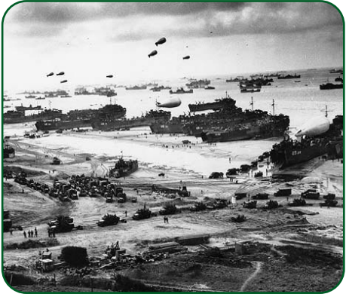
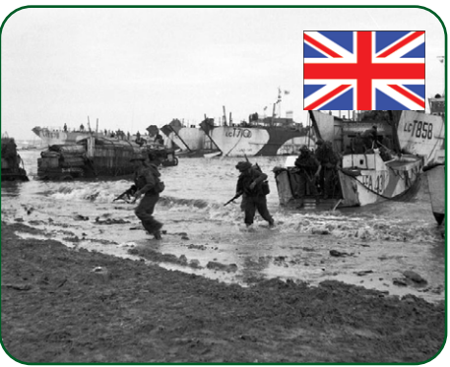
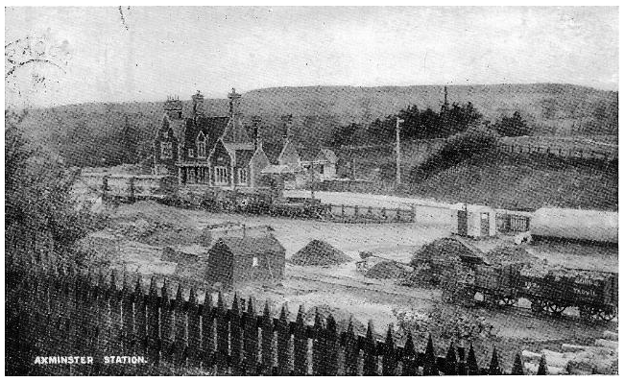
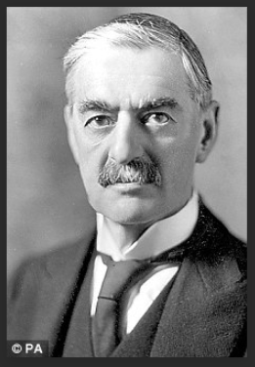
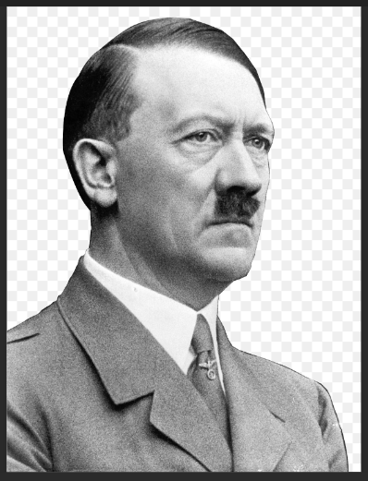
WW2 – by the end of this topic you will know the significance of D-Day and the causes of WW2.
Key Vocabulary
D Day | 6th June 1944 in the Second World War on which Allied forces invaded northern France by means of beach landings in Normandy.
WW2 | A world war that lasted from 1939 to 1945
Global conflict | Lots of countries around the world involved in a serious disagreement or argument.
Axis | The Axis Powers was a military group that fought in World War 2 against the Allies. The three main Axis powers were Germany, Japan and Italy.
Allies | The Allied Powers were a group of nations that fought against the Axis countries in World War 2. The Allied Powers initially consisted of the UK, France and Poland. Later joined by the US, Russia and China..
Democracy | Democracg is a form of government in which the people have the authority to decide on laws, or to choose people to do so.
Transport | Different countries used different vehicles or aircraft to fight.
Troops | Soldiers who are fighting
2. To use a range of sources to find out about D- Day
3. 2. To use a range of sources to find out about D- Day
The D-Day landings in 1944 were the biggest invasion by sea in history. It's a key date in the story of WW2.
The landings took place on 6 June after five years of war with Germany, who were led by the Nazis. The whole operation was codenamed Operation Overlord.
A massive military force set out from the UK towards France.
4. To understand the impact of the railway
Axminster Station in about 1906.
The station was used to transport troops to the coast.
To know and discuss the causes of WW11
Germany felt humiliated by the Treaty of Versailles
which aimed to prevent German beginning a new war
2. Growth of Fascism and Nazism Mussolini (Italy)
and Hitler (Germany) strongly glorified war and violence.
3. The rise of Japan
4. New countries like Poland, Czechoslovakia and Austria were formed after the First World War. While drawing boundaries the interests of minority groups in each of these countries were neglected.
5.To bring together conclusions from different sources and to demonstrate an understanding of the topic
Look at sources from this period and write a news paper article about this period in history.

